Slide 1

Do Physical activity tracker influence the level of physical activity?
WEEK 6: STATISTICAL PROJECT
FITNESS
FITNESS
FITNESS
FITNESS
FITNESS
FITNESS
FITNESS
Ekraj Pokhrel

Slide 2

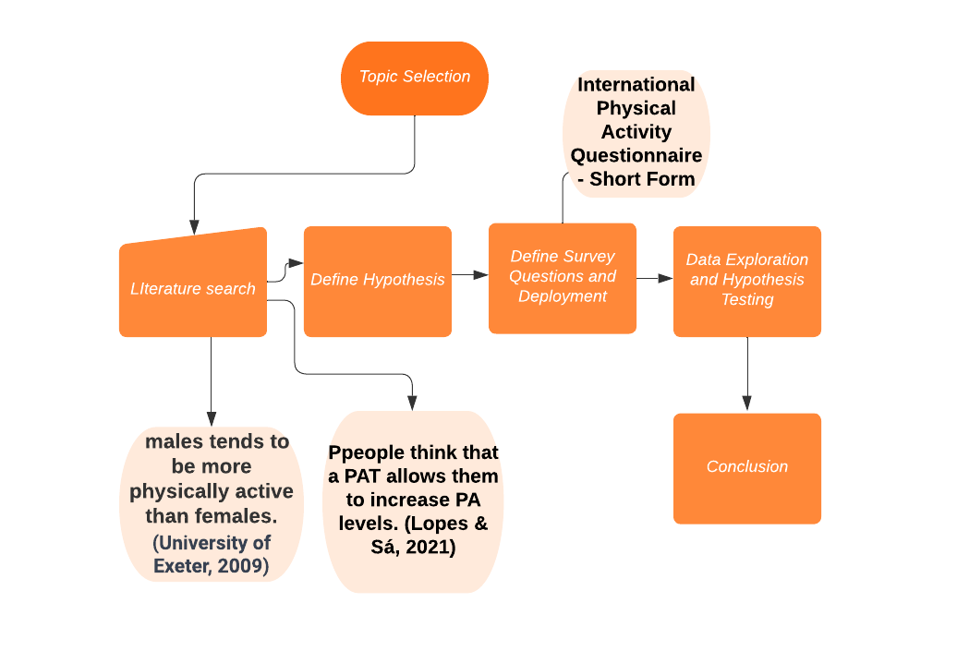
Project workflow

Slide 3

INTRODUCTION
This project study the relationship between the use of physical activity trackers (PATs) and physical activity level.
Convenience survey used in the project, questionnaires is designed based on the International Physical Activity Questionnaire - Short Form, which is a validated tool for assessing physical activity levels.
The total fitness level of participants is measured using the metabolism equivalent of task (MET) values, which provide a standardized measure of the intensity of different physical activities.

Slide 4
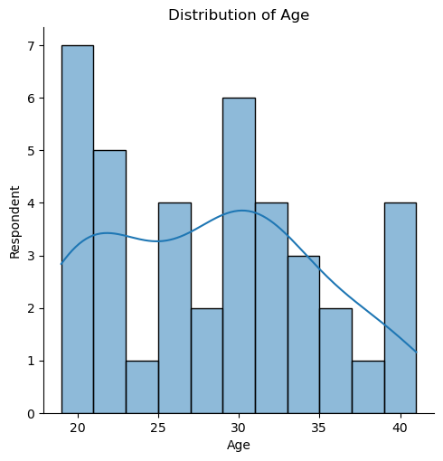
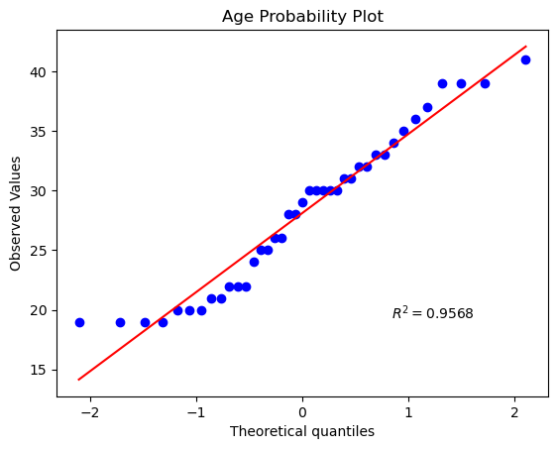
Data Exploration

Slide 5
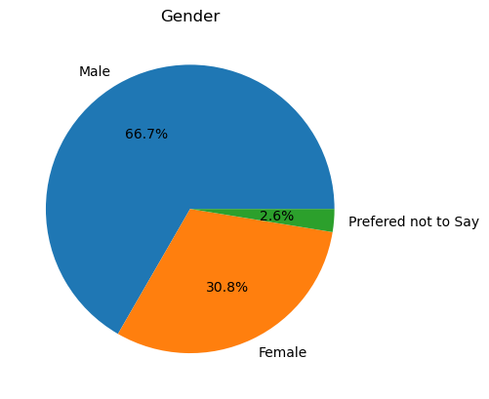
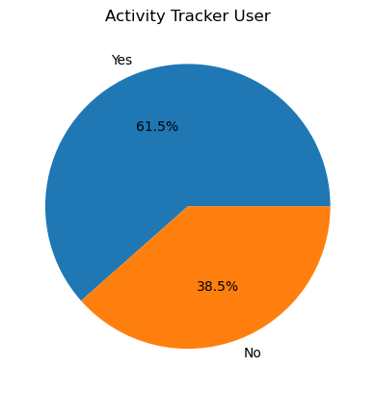
Data Exploration

Slide 6
Define Hypothesis
1. H0: PAT user tends to be more physically active than non-PAT user. Test on all level of physical activities
- > Independent sample t-test on all the level of physical activities
2. H0: there is no difference in physical activity levels between males and females.
-> Independent sample t-test on all level of physical activities
3. H0: Individuals who engage in vigorous physical activity (VPAs) have higher levels of moderate physical activity (MPAs) compared to those who do not engage in VPAs.
-> Independent sample t-test
4. H0: Gender does not influence the use of PAT
-> chi2_contingency : goodness of fit and association test

Slide 7
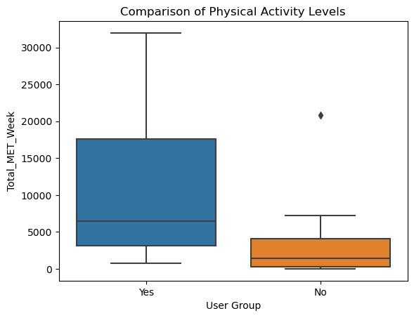
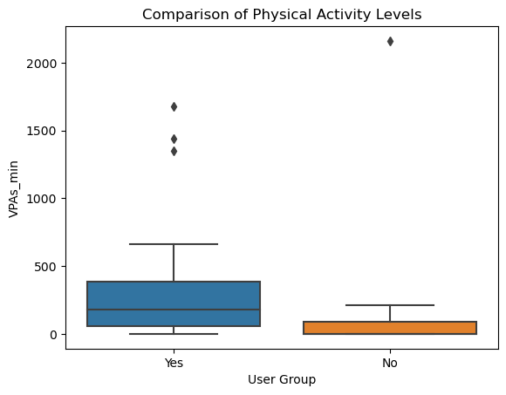
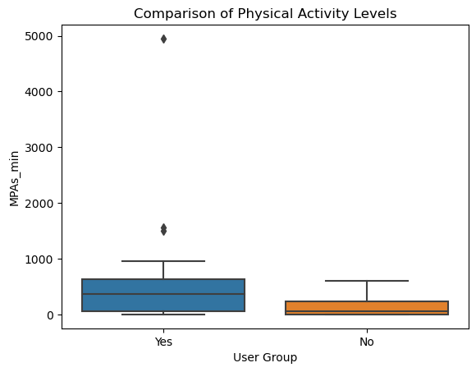
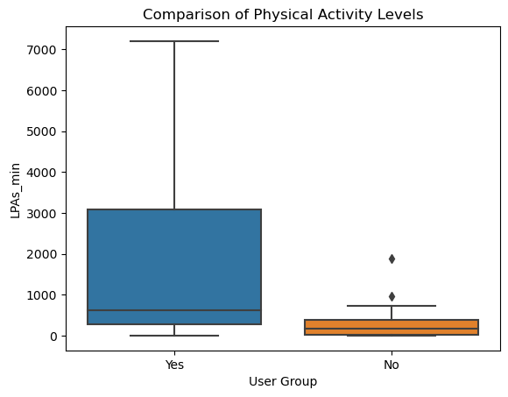
Hypothesis test
1. H0: PAT user tends to be more physically active than non-PAT user.
Alpha = 0.05
H0: pat_user_mu <= non_pat_user_mu
H1: pat_user_mu > non_pat_user_mu
-> weekly Metabolic equivalent of task (MET): p-value: 0.00148
-> VPAs_min : p-value: 0.160
-> MPAs_min : p-value: 0.0197
-> LPAs_min: p-value: 0.002
From above we can say that physical activity tracker user tends to be more active in moderate and lower-level physical activities. Also, they tend to have more metabolic equivalent of task compared to non-physical activity tracker user.

Slide 8
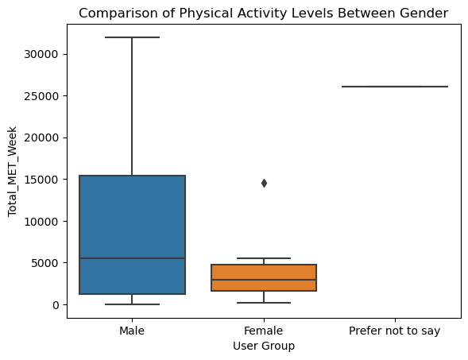
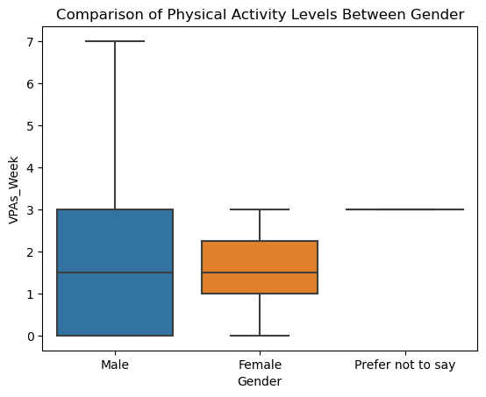
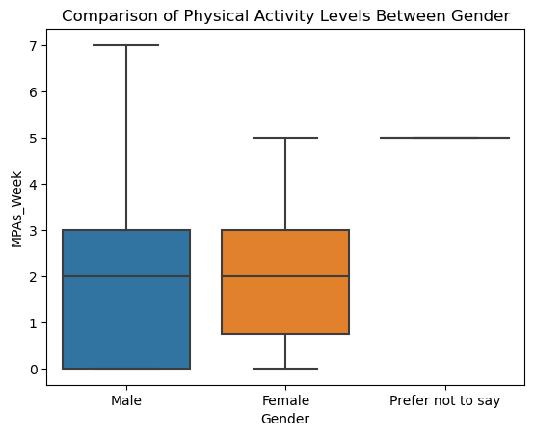

Hypothesis test
2. H0: There is no difference in level of physical activity between males and females.
Alpha = 0.05
H0: male_mu == female_mu
H1: male_mu != female_mu
-> Weekly Metabolic equivalent of task (MET): p-value: 0.00297
-> VPAs_min : p-value: 0.00076
-> MPAs_min : p-value: 0.0116
-> LPAs_min: p-value: 0.0415
From this test of hypothesis I can reject the null hypothesis, that is at all the level of physical activities males tends to be more active than female. Also, metabolic equivalent of task is higher in male than of female

Slide 9
Hypothesis test
3. H0: Individuals who engage in vigorous physical activity (VPAs) have higher levels of moderate physical activity (MPAs)
Alpha = 0.05
H0: VPA_engaged_mu <= VPA_not_engaged_mu
H1: VPA_engaged_mu > VPA_not_engaged_mu
P-value = 0.0113
H0: Individuals who engage in vigorous physical activity (VPAs) have higher levels of lower physical activity (LPAs)
P-value = 0.3031
From this analysis i can say that person engaged in vigorous physical activities also tends to have higher level of moderate physical activities.
But I don’t have sufficient evidence to say that: person engaged in vigorous physical activities also tends to have higher level of lower physical activities.

Slide 10
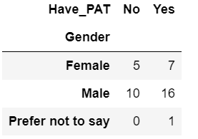

Hypothesis test
4. H0: Gender does not influence the use of PAT
Alpha = 0.05
Observed
Expected
P-value = 0.713
I can conclude that there is no significant association between gender and the use of PAT (Physical Activity Tracker). Therefore, we fail to reject the null hypothesis (H0: Gender does not influence the use of PAT)

Slide 11

THANK YOU
THANK
YOU
THANK
YOU
THANK
YOU
THANK
Ekraj Pokhrel

